Slide 1
Rating Hospital Performance
Brining Consumerism to Healthcare
June 5th, 2019
Presenters: Marin Gow, Michael Diarra, Venku Buragadda, Zain Iqbal & Zain Jafri

Slide 2
Data Overview & Exploration
Datasets:
Survey Data: A list of hospital ratings for the Hospital Consumer Assessment of Healthcare Providers and Systems (HCAHPS). HCAHPS is a national, standardized survey of hospital patients about their experiences during a recent inpatient hospital stay.
Complications and Deaths: Complications and deaths - provider data. This data set includes provider-level data for the hip/knee complication measure, the CMS Patient Safety Indicators, and 30-day death rates.
Variables:
Predictor variables: Variables from Survey dataset and Complications dataset.
Response variables: Predicting Hospital Recommendation Score (for Regression models) and Start Rating for (Categorical models)
Notes:
Talk about our dataset. We have two dataset one with Survey and other with complication. We are trying to use both to predict hospital recommended score or star rating.
Total dataset counts
Talk about the counts of records per state and to highlight the states for which we have more records. Etc.
Talk about what we have decided to select as our predictors and Y columns (H_RECMND_LINEAR_SCORE for regression and (STAR_RATING) which we created based on the ranges provided by the survey’ier.
Talk about how we used our business knowledge and decide on the fields that we think are most important to predict the hospital recommendation system
Talk little bit about the data and the values in some of the columns (like the range of the values or how it is calculated)
Talk about TSNE that we ran after we have selected the columns we decided to use. Note that we used a learning rate of 150 for this and we used c akka color as Zip code for this plot.
Talk about our initial though on how we though DBSCAN might work this data etc.
Talk about other methods like PCA that we applied.
Also mention about about lot of NA in our data which---when we remove the NA’s is bring down the data from 4900 records to 1000 records apprx (let them more about it in next few slide).
Talk about the correlation plot and talk little bit on the columns that are correlated - <<<add more about this here >>>
Selection of predictors:
31 predictors selected between both the datasets.
From Survey data we have selected the Linear Scores as the predictors.
From Complication data we have selected Mortality and PSI as the predictors.

Slide 3
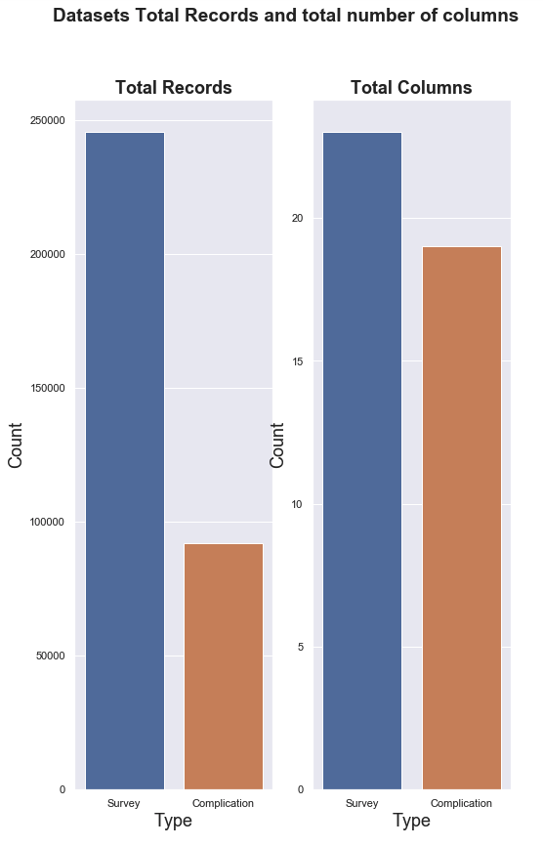
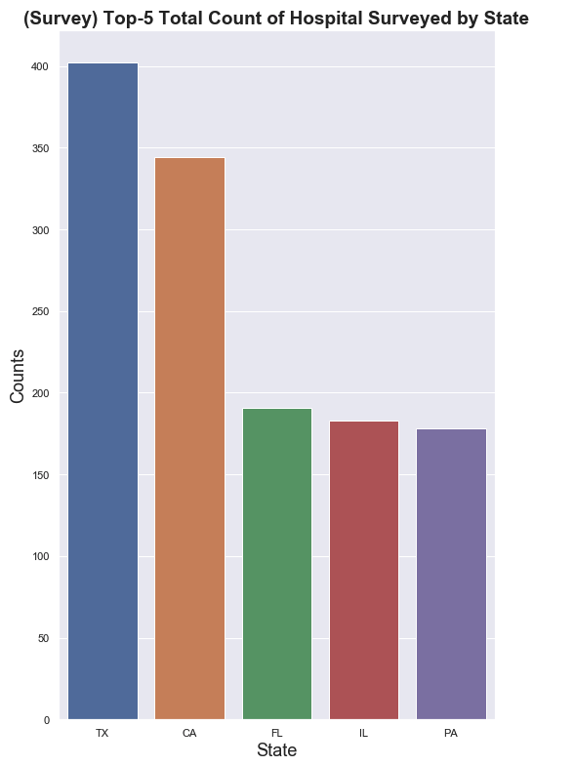

Data Overview & Exploration
Notes:
Talk about our dataset. We have two dataset one with Survey and other with complication. We are trying to use both to predict hospital recommended score or star rating.
Total dataset counts
Talk about the counts of records per state and to highlight the states for which we have more records. Etc.
Talk about what we have decided to select as our predictors and Y columns (H_RECMND_LINEAR_SCORE for regression and (STAR_RATING) which we created based on the ranges provided by the survey’ier.
Talk about how we used our business knowledge and decide on the fields that we think are most important to predict the hospital recommendation system
Talk little bit about the data and the values in some of the columns (like the range of the values or how it is calculated)
Talk about TSNE that we ran after we have selected the columns we decided to use. Note that we used a learning rate of 150 for this and we used c akka color as Zip code for this plot.
Talk about our initial though on how we though DBSCAN might work this data etc.
Talk about other methods like PCA that we applied.
Also mention about about lot of NA in our data which---when we remove the NA’s is bring down the data from 4900 records to 1000 records apprx (let them more about it in next few slide).
Talk about the correlation plot and talk little bit on the columns that are correlated - <<<add more about this here >>>
Selection of predictors:
31 predictors selected between both the datasets.
From Survey data we have selected the Linear Scores as the predictors.
From Complication data we have selected Mortality and PSI as the predictors.

Slide 4
Data Overview & Exploration
Survey Data:
Complication Data:
HCAHPS Question | HCAHPS Measure ID
Communication about medicines - linear mean score | H_COMP_5_LINEAR_SCORE
Cleanliness - linear mean score | H_CLEAN_LINEAR_SCORE
Recommend hospital - linear mean score | H_RECMND_LINEAR_SCORE
Care transition - linear mean score | H_COMP_7_LINEAR_SCORE
Overall hospital rating - linear mean score | H_HSP_RATING_LINEAR_SCORE
Doctor communication - linear mean score | H_COMP_2_LINEAR_SCORE
Nurse communication - linear mean score | H_COMP_1_LINEAR_SCORE
Discharge information - linear mean score | H_COMP_6_LINEAR_SCORE
Staff responsiveness - linear mean score | H_COMP_3_LINEAR_SCORE
Quietness - linear mean score | H_QUIET_LINEAR_SCORE
Measure Name | Measure ID
Rate of complications for hip/knee replacement patients | COMP_HIP_KNEE
Death rate for heart attack patients | MORT_30_AMI
Death rate for CABG surgery patients | MORT_30_CABG
Death rate for COPD patients | MORT_30_COPD
Death rate for heart failure patients | MORT_30_HF
Death rate for pneumonia patients | MORT_30_PN
Death rate for stroke patients | MORT_30_STK
Postoperative Acute Kidney Injury Requiring Dialysis Rate | PSI_10_POST_KIDNEY
Postoperative Respiratory Failure Rate | PSI_11_POST_RESP
Serious blood clots after surgery | PSI_12_POSTOP_PULMEMB_DVT
Blood stream infection after surgery | PSI_13_POST_SEPSIS
A wound that splits open after surgery on the abdomen or pelvis | PSI_14_POSTOP_DEHIS
Accidental cuts and tears from medical treatment | PSI_15_ACC_LAC
Pressure sores | PSI_3_ULCER
Deaths among Patients with Serious Treatable Complications after Surgery | PSI_4_SURG_COMP
Collapsed lung due to medical treatment | PSI_6_IAT_PTX
Broken hip from a fall after surgery | PSI_8_POST_HIP
Perioperative Hemorrhage or Hematoma Rate | PSI_9_POST_HEM
Serious complications | PSI_90_SAFETY
Notes:
Talk about our dataset. We have two dataset one with Survey and other with complication. We are trying to use both to predict hospital recommended score or star rating.
Total dataset counts
Talk about the counts of records per state and to highlight the states for which we have more records. Etc.
Talk about what we have decided to select as our predictors and Y columns (H_RECMND_LINEAR_SCORE for regression and (STAR_RATING) which we created based on the ranges provided by the survey’ier.
Talk about how we used our business knowledge and decide on the fields that we think are most important to predict the hospital recommendation system
Talk little bit about the data and the values in some of the columns (like the range of the values or how it is calculated)
Talk about TSNE that we ran after we have selected the columns we decided to use. Note that we used a learning rate of 150 for this and we used c akka color as Zip code for this plot.
Talk about our initial though on how we though DBSCAN might work this data etc.
Talk about other methods like PCA that we applied.
Also mention about about lot of NA in our data which---when we remove the NA’s is bring down the data from 4900 records to 1000 records apprx (let them more about it in next few slide).
Talk about the correlation plot and talk little bit on the columns that are correlated - <<<add more about this here >>>
Selection of predictors:
31 predictors selected between both the datasets.
From Survey data we have selected the Linear Scores as the predictors.
From Complication data we have selected Mortality and PSI as the predictors.

Slide 5
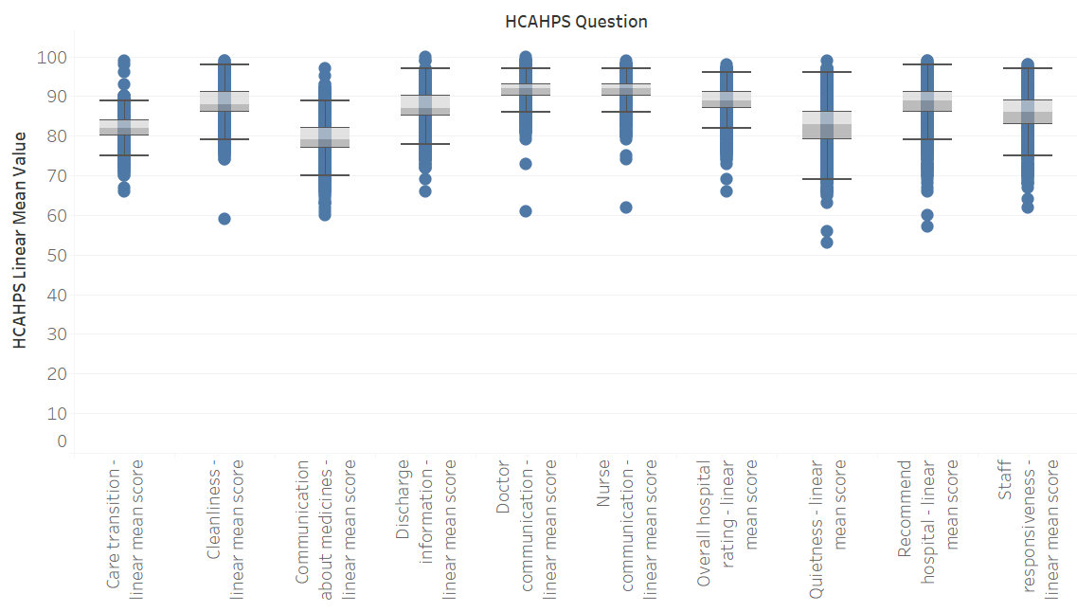
Data Overview & Exploration
Survey dataset- HCAHPS question vs Linear Mean values boxplot.
Notes:
Talk about our dataset. We have two dataset one with Survey and other with complication. We are trying to use both to predict hospital recommended score or star rating.
Total dataset counts
Talk about the counts of records per state and to highlight the states for which we have more records. Etc.
Talk about what we have decided to select as our predictors and Y columns (H_RECMND_LINEAR_SCORE for regression and (STAR_RATING) which we created based on the ranges provided by the survey’ier.
Talk about how we used our business knowledge and decide on the fields that we think are most important to predict the hospital recommendation system
Talk little bit about the data and the values in some of the columns (like the range of the values or how it is calculated)
Talk about TSNE that we ran after we have selected the columns we decided to use. Note that we used a learning rate of 150 for this and we used c akka color as Zip code for this plot.
Talk about our initial though on how we though DBSCAN might work this data etc.
Talk about other methods like PCA that we applied.
Also mention about about lot of NA in our data which---when we remove the NA’s is bring down the data from 4900 records to 1000 records apprx (let them more about it in next few slide).
Talk about the correlation plot and talk little bit on the columns that are correlated - <<<add more about this here >>>
Selection of predictors:
31 predictors selected between both the datasets.
From Survey data we have selected the Linear Scores as the predictors.
From Complication data we have selected Mortality and PSI as the predictors.

Slide 6
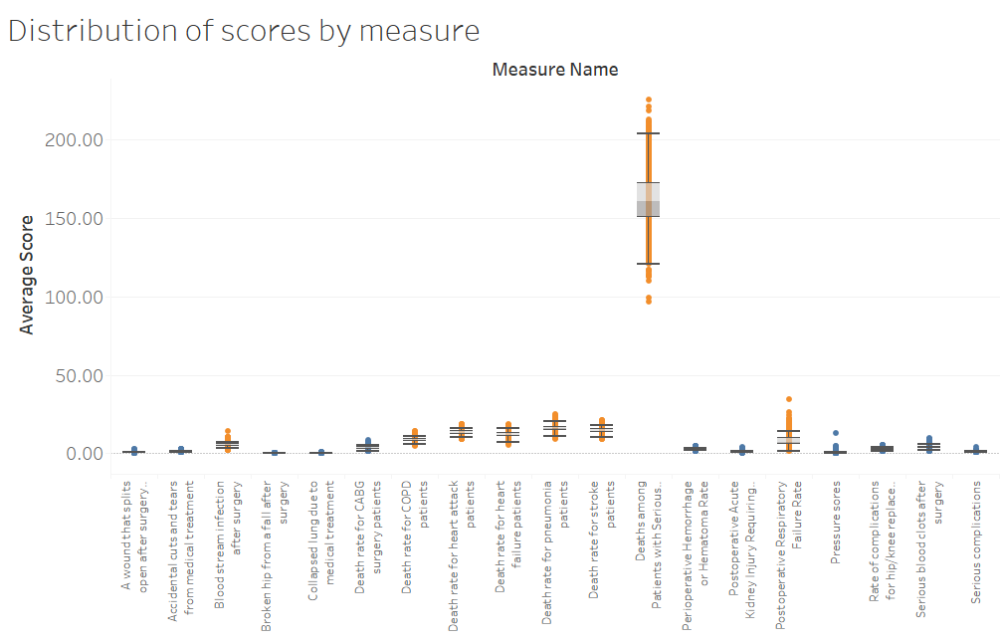
Data Overview & Exploration
Complication dataset- Measure and the Scores boxplot.
Notes:
Talk about our dataset. We have two dataset one with Survey and other with complication. We are trying to use both to predict hospital recommended score or star rating.
Total dataset counts
Talk about the counts of records per state and to highlight the states for which we have more records. Etc.
Talk about what we have decided to select as our predictors and Y columns (H_RECMND_LINEAR_SCORE for regression and (STAR_RATING) which we created based on the ranges provided by the survey’ier.
Talk about how we used our business knowledge and decide on the fields that we think are most important to predict the hospital recommendation system
Talk little bit about the data and the values in some of the columns (like the range of the values or how it is calculated)
Talk about TSNE that we ran after we have selected the columns we decided to use. Note that we used a learning rate of 150 for this and we used c akka color as Zip code for this plot.
Talk about our initial though on how we though DBSCAN might work this data etc.
Talk about other methods like PCA that we applied.
Also mention about about lot of NA in our data which---when we remove the NA’s is bring down the data from 4900 records to 1000 records apprx (let them more about it in next few slide).
Talk about the correlation plot and talk little bit on the columns that are correlated - <<<add more about this here >>>
Selection of predictors:
31 predictors selected between both the datasets.
From Survey data we have selected the Linear Scores as the predictors.
From Complication data we have selected Mortality and PSI as the predictors.

Slide 7
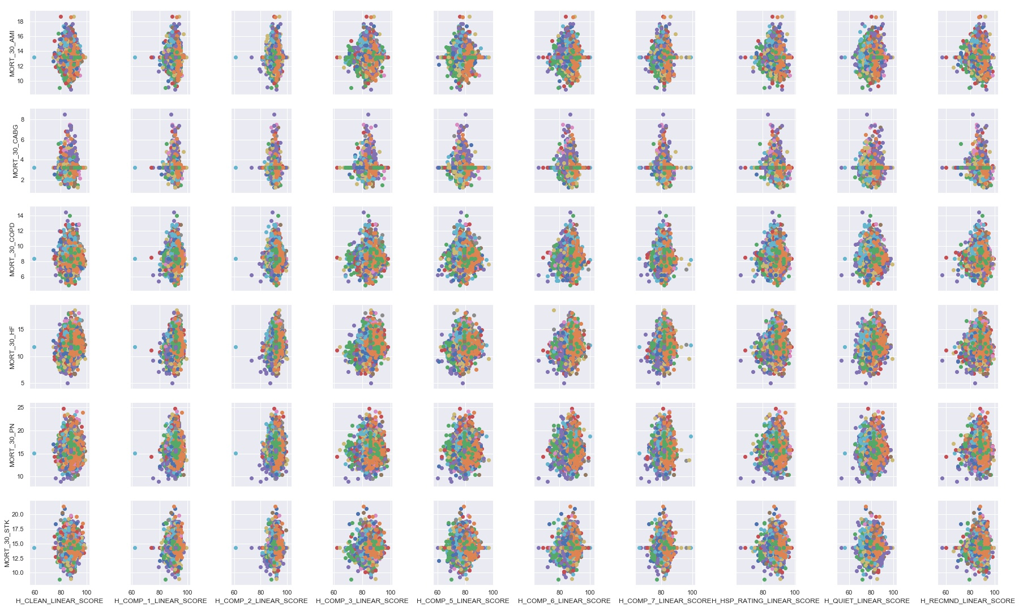
Data Overview & Exploration
Notes:
Talk about our dataset. We have two dataset one with Survey and other with complication. We are trying to use both to predict hospital recommended score or star rating.
Total dataset counts
Talk about the counts of records per state and to highlight the states for which we have more records. Etc.
Talk about what we have decided to select as our predictors and Y columns (H_RECMND_LINEAR_SCORE for regression and (STAR_RATING) which we created based on the ranges provided by the survey’ier.
Talk about how we used our business knowledge and decide on the fields that we think are most important to predict the hospital recommendation system
Talk little bit about the data and the values in some of the columns (like the range of the values or how it is calculated)
Talk about TSNE that we ran after we have selected the columns we decided to use. Note that we used a learning rate of 150 for this and we used c akka color as Zip code for this plot.
Talk about our initial though on how we though DBSCAN might work this data etc.
Talk about other methods like PCA that we applied.
Also mention about about lot of NA in our data which---when we remove the NA’s is bring down the data from 4900 records to 1000 records apprx (let them more about it in next few slide).
Talk about the correlation plot and talk little bit on the columns that are correlated - <<<add more about this here >>>
Selection of predictors:
31 predictors selected between both the datasets.
From Survey data we have selected the Linear Scores as the predictors.
From Complication data we have selected Mortality and PSI as the predictors.

Slide 8
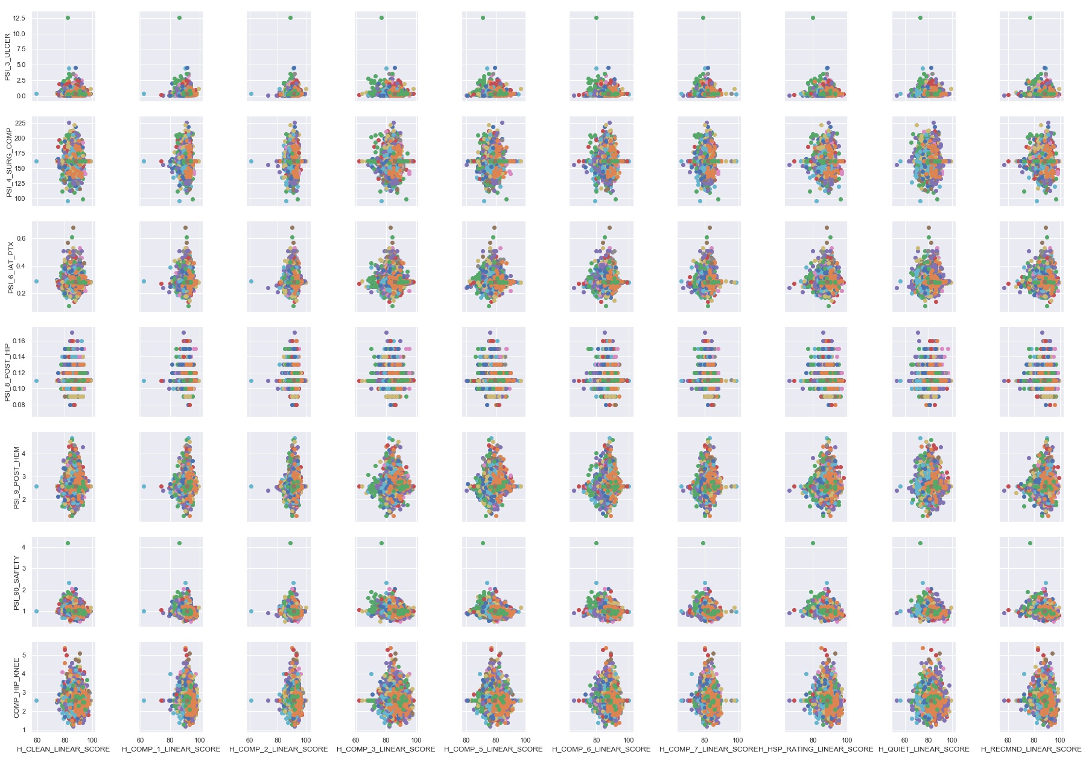
Data Overview & Exploration
Notes:
Talk about our dataset. We have two dataset one with Survey and other with complication. We are trying to use both to predict hospital recommended score or star rating.
Total dataset counts
Talk about the counts of records per state and to highlight the states for which we have more records. Etc.
Talk about what we have decided to select as our predictors and Y columns (H_RECMND_LINEAR_SCORE for regression and (STAR_RATING) which we created based on the ranges provided by the survey’ier.
Talk about how we used our business knowledge and decide on the fields that we think are most important to predict the hospital recommendation system
Talk little bit about the data and the values in some of the columns (like the range of the values or how it is calculated)
Talk about TSNE that we ran after we have selected the columns we decided to use. Note that we used a learning rate of 150 for this and we used c akka color as Zip code for this plot.
Talk about our initial though on how we though DBSCAN might work this data etc.
Talk about other methods like PCA that we applied.
Also mention about about lot of NA in our data which---when we remove the NA’s is bring down the data from 4900 records to 1000 records apprx (let them more about it in next few slide).
Talk about the correlation plot and talk little bit on the columns that are correlated - <<<add more about this here >>>
Selection of predictors:
31 predictors selected between both the datasets.
From Survey data we have selected the Linear Scores as the predictors.
From Complication data we have selected Mortality and PSI as the predictors.

Slide 9
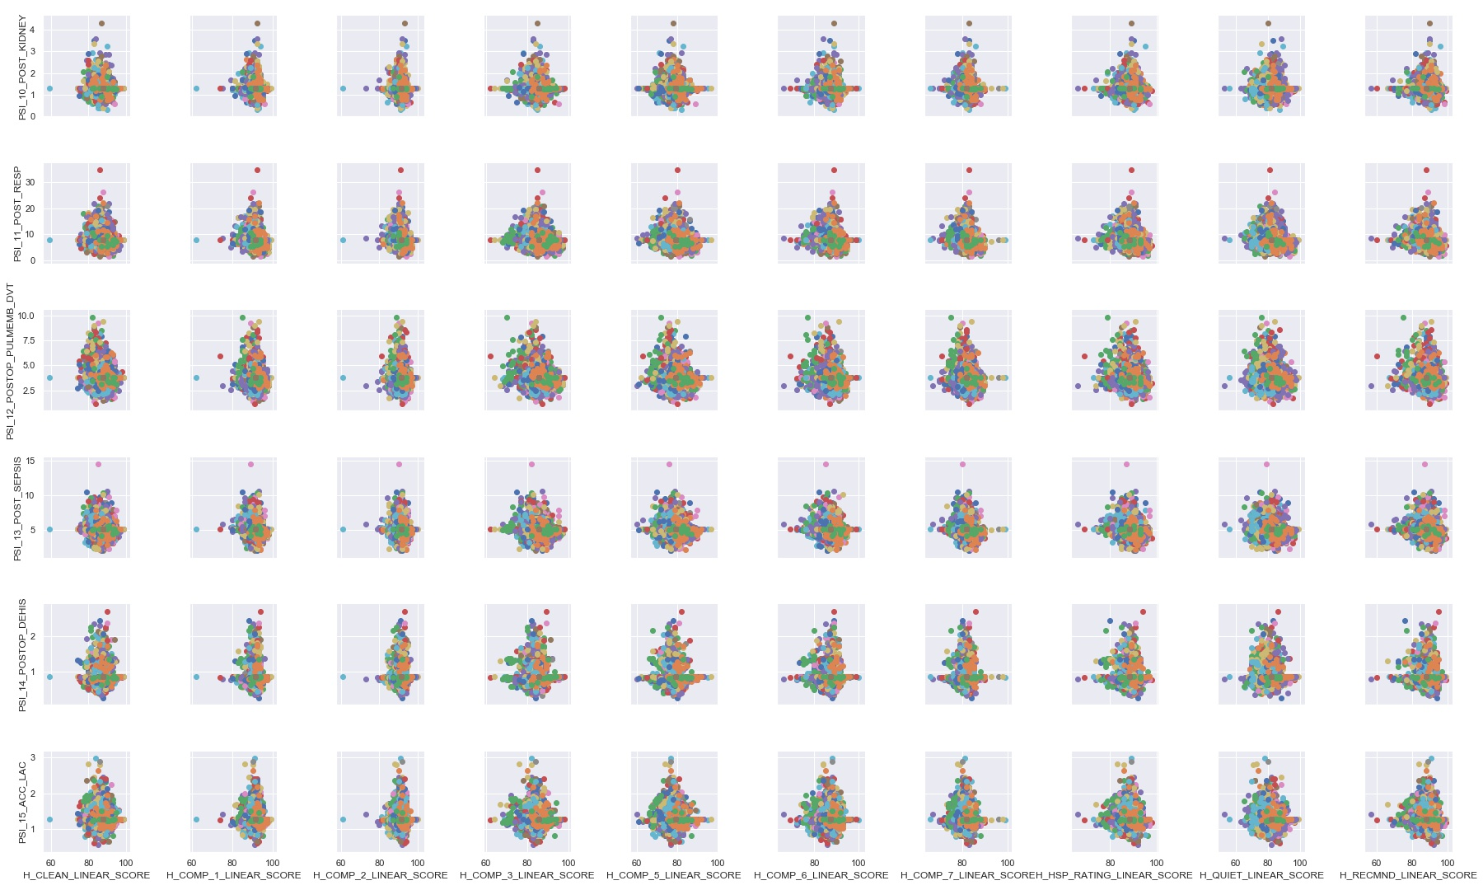
Data Overview & Exploration
Notes:
Talk about our dataset. We have two dataset one with Survey and other with complication. We are trying to use both to predict hospital recommended score or star rating.
Total dataset counts
Talk about the counts of records per state and to highlight the states for which we have more records. Etc.
Talk about what we have decided to select as our predictors and Y columns (H_RECMND_LINEAR_SCORE for regression and (STAR_RATING) which we created based on the ranges provided by the survey’ier.
Talk about how we used our business knowledge and decide on the fields that we think are most important to predict the hospital recommendation system
Talk little bit about the data and the values in some of the columns (like the range of the values or how it is calculated)
Talk about TSNE that we ran after we have selected the columns we decided to use. Note that we used a learning rate of 150 for this and we used c akka color as Zip code for this plot.
Talk about our initial though on how we though DBSCAN might work this data etc.
Talk about other methods like PCA that we applied.
Also mention about about lot of NA in our data which---when we remove the NA’s is bring down the data from 4900 records to 1000 records apprx (let them more about it in next few slide).
Talk about the correlation plot and talk little bit on the columns that are correlated - <<<add more about this here >>>
Selection of predictors:
31 predictors selected between both the datasets.
From Survey data we have selected the Linear Scores as the predictors.
From Complication data we have selected Mortality and PSI as the predictors.

